Slide 1
Getting Started In .Net
Tools and Processes Used Basic .NET Projects
Nate Buwalda
Cijug october 2014

Slide 2
Agenda
Cost of Entry
Visual Studio
C# Basics
Web Frameworks
Test Frameworks
Build Tools and Dependency Management

Slide 3
Cost of Entry
IDE and Platform Costs

Slide 4
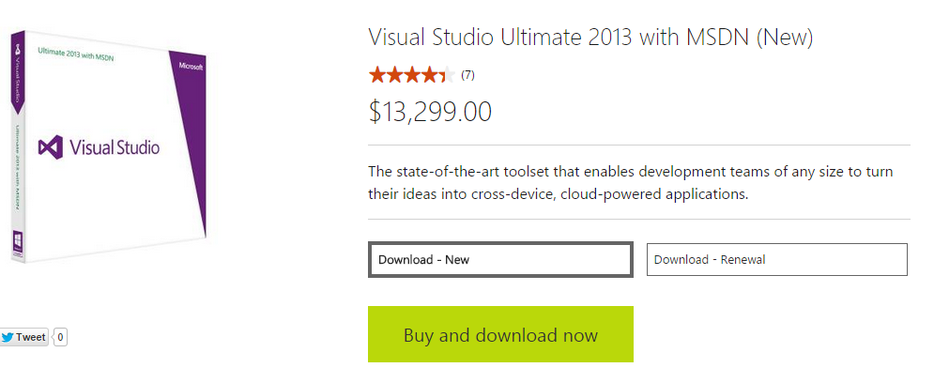
Cost of Entry
Scary!
This is usually what most people see or think when they are confronted with doing .NET development.

Slide 5
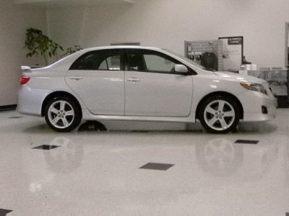
Cost of Entry
What can that buy?
2009 Toyota Corolla

Slide 6
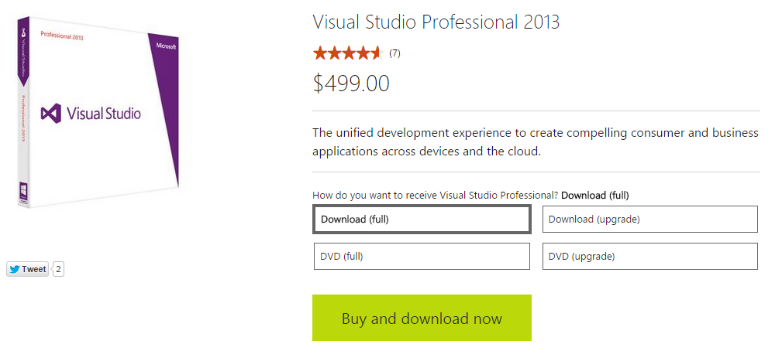
Cost of Entry
Is there hope?
You probably do no need Ultimate
MSDN is nice, but probably do not need that either
How about Professional?

Slide 7

Cost of Entry
But that is still monies...
... how about free?
Microsoft Bizspark
Developer 90-day Trial License
Visual Studio Express Editions

Slide 8
Visual Studio
The Answer To All of The Other Questions

Slide 9
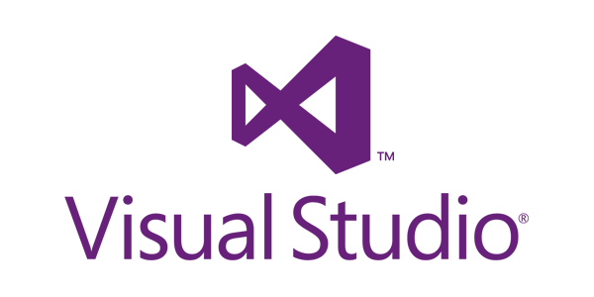
Visual Studio
More than an IDE
Acts as the center of all development activities for .NET
Provides capabilities for architecture, design, source control, building, compiling, deploying, and more

Slide 10
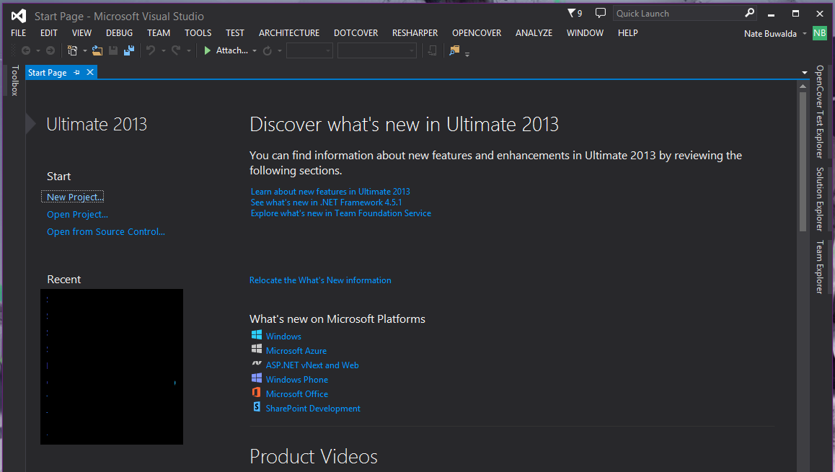
Visual Studio
Features
Start page provides quick links to relevant information and tutorials
Robust extension manager for add-ons
Built-in integration with Visual Studio Online and Microsoft Azure cloud services

Slide 11

Visual Studio
JetBrains ReSharper
Provides (almost) all of the refactoring capabilities of IntelliJ
Adds in rich test runners
Helps with more complicated formatting and enforcement of style guidelines

Slide 12
C# Basics
Syntax, Structures, And Considerations

Slide 13
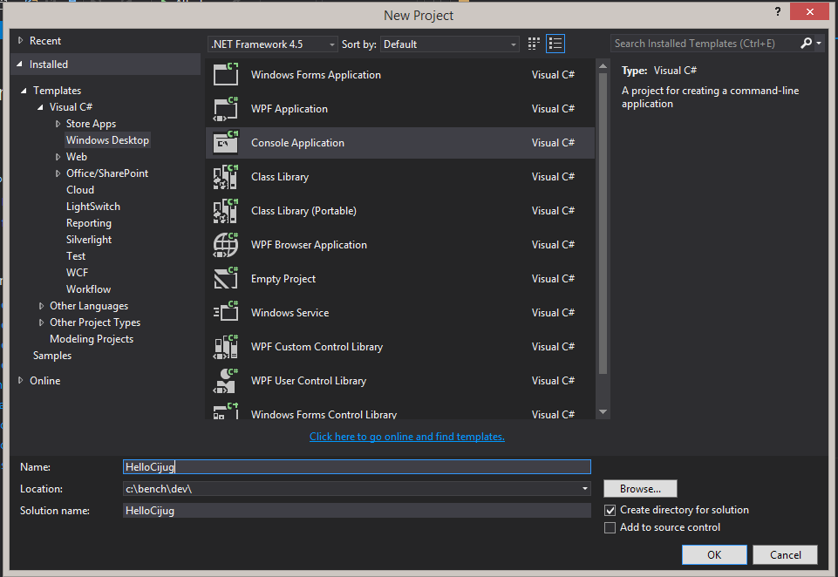
C# Basics
Starting A New Application
Applications are made up of a solution which may contain one or more project

Slide 14
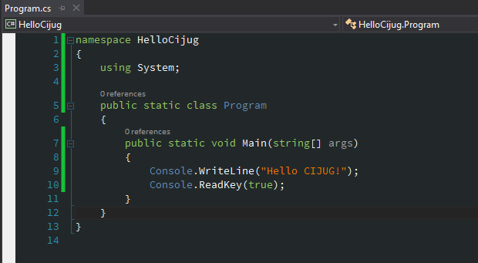
C# Basics
Hello World
An executable must have a class with a static void Main method
Basic class syntax should feel very familiar

Slide 15
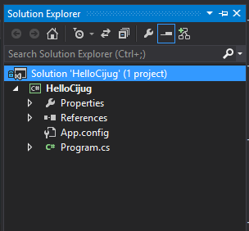
C# Basics
Hello World
All projects have properties and references listed in the Solution Explorer

Slide 16
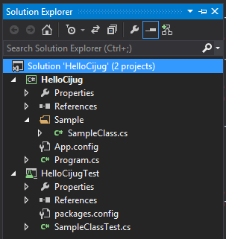
C# Basics
Solution with Test Projects
As applications grow, additional projects are added with code organized into different source folders

Slide 17
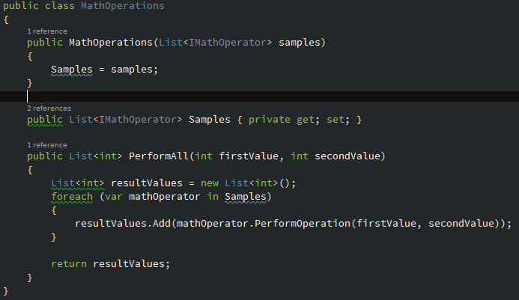
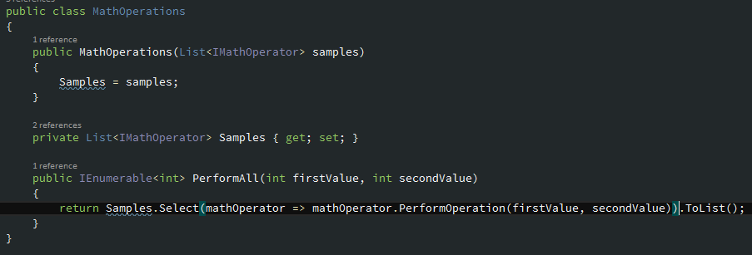
C# Basics
Without Lambdas
With Lambdas

Slide 18
Web Frameworks
Web Applications and Web Services

Slide 19
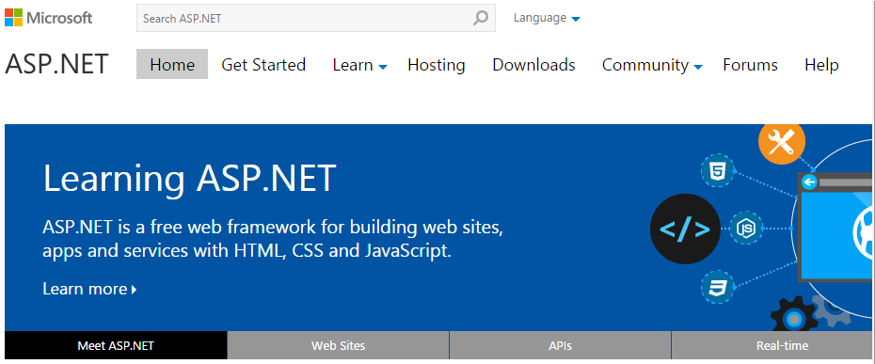
Web Frameworks
ASP .NET
Has an older code heavy approach to page layout
Prefer to work with ASP .NET MVC, which is very much like Spring MVC with JSPs
Some cool new interactive web frameworks such as SignalR

Slide 20
Web Frameworks
Internet Information Services (IIS)
Comes as part of Windows Server
Manages the lifecycle and request routing of ASP .NET applications
OWIN Katana
A self-contained executable web server
Deployed and managed like any other executable program

Slide 21
Test Frameworks
Unit Testing and Acceptance Testing

Slide 22

Test Frameworks
Unit Testing
NUnit – very similar to JUnit, including before, after, and other setup helpers
xUnit – a more .NET oriented way to test with setup and teardown controlled by C# code structures

Slide 23
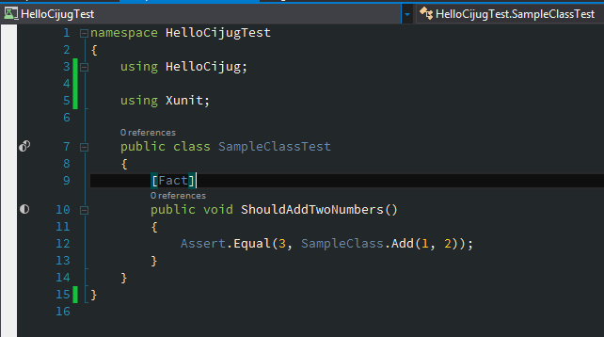
Test Frameworks
Unit Testing
Tests generally go in their own project inside the same solution

Slide 24
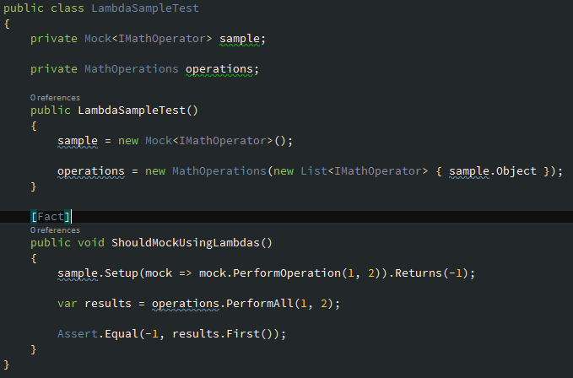
Test Frameworks
Unit Testing - Mocks
Moq is a library that uses lambdas to set and verify expectations

Slide 25
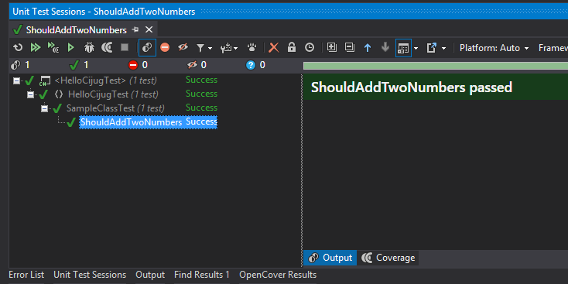
Test Frameworks
Test Results
Two ways to run tests if you have Resharper installed
Run through Test Explorer
Create a Resharper Test Session

Slide 26

Test Frameworks
Acceptance Testing
SpecFlow – a Cucumber implementation for .NET

Slide 27
Build Tools
Building and Managing Dependencies

Slide 28

Build Tools
Most project builds are managed through Visual Studio
Automation can be done via
MSBuild
NAnt
Several other build scripting DSLs

Slide 29

Build Tools
Dependencies can be managed via NuGet
Similar to Ivy or the dependency management parts of Maven

Slide 30
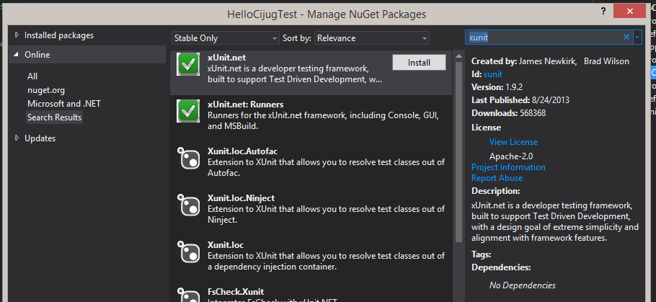
Build Tools
More on NuGet
Managed through Package Console in Visual Studio
Handles most transitive dependencies

Slide 31
Closing remarks
Questions?

Slide 32
Contact me
natebuwalda@gmail.com
http://github.com/natebuwalda
@scotchnate
Thanks!

